Slide 1


Capstone Project - The Battle of Neighborhoods
Location selection
Based on
Data Science

Slide 2
Objective
Leverage the Foursquare location data to explore or compare neighbourhoods or cities of your choice or to come up with a problem that you can use the Foursquare location data to solve.
The submission should include:
Week 1:
A description of the problem and a discussion of the background. (15 marks)
A description of the data and how it will be used to solve the problem. (15 marks)
Week 2:
A link to your Notebook on your Github repository, showing your code. (15 marks)
A full report consisting of all of the following components (15 marks):
Introduction where you discuss the business problem and who would be interested in this project.
Data where you describe the data that will be used to solve the problem and the source of the data.
Methodology section which represents the main component of the report
Results section where you discuss the results.
Discussion section.
Conclusion section where you conclude the report.
Your choice of a presentation or blogpost. (10 marks)

Slide 3
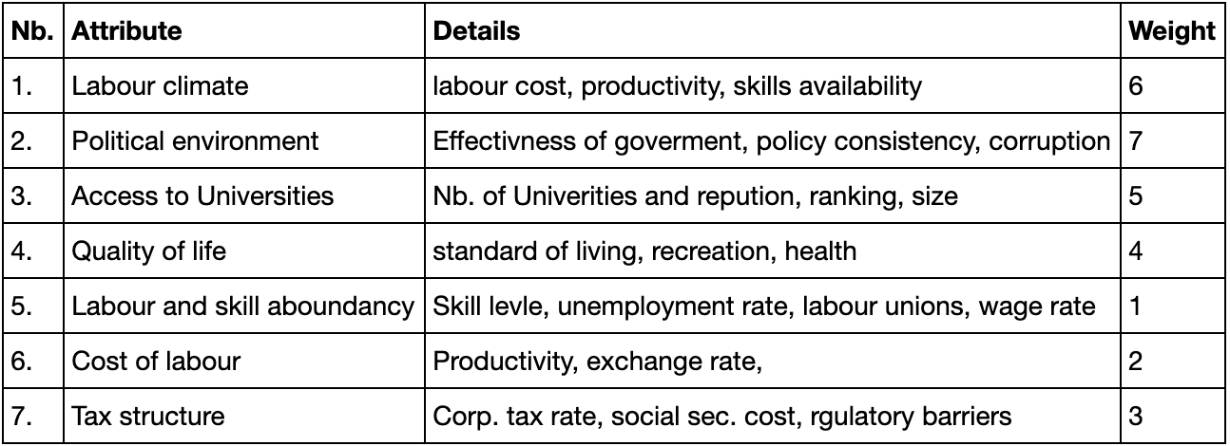
Introduction
Each of these cities are attractive places to live and work. All are very close to international airports and are appreciated by Expats. The organisation wants to settle his new headquarter based on the following decision matrix:
For this assignment it is assumed that we advice a company in their decision process of choosing a location for their Europe headquarter. The company has pre-selected three cities in which a local office already exists:
London (GBP)
Zurich (CHE)
Barcelona (SPA)

Slide 4
Data Sources
The sources of data acquired for this assignment are
well known
regarded NGO institutions
Government sites
data collection platforms e.g. Foursquare
Name of organization | Data access / Report | Data attributes | File format
Foursquare | API | Id, name, contact, location, categories, verified, stats, url, hours, popular, menu, price, rating, hereNow, storeId, description | API (json)
OECD | Unemployment | Annual, harmonised unemployment rate in %, over 10 years | API (csv)
OECD | Unit labour cost | Annual, Unit labour costs and labour productivity (employment based), Total economy in %, over 10years | API (csv)
OECD | Corporate Tax | Statutory corporate income tax rate, Total economy in %, over 10years | API (csv)
OECD | Labour wage | Average annual wages, Total economy in EUR, over 10years | API (csv)
Transparency International | CPI Data Set | CPI rank, CPI score, CPI std. error | XLS
Opendata.swiss | Swiss city index | Administration, Construction and housing, Crime, criminal justice, Culture, media, information society, sport, National economy, Education and science, Energy, Finances, Geography, Mobility and Transport, Public order and security, Politics, Population, Prices, Social security, Health, Territory and environment, Tourism, Work and income | API (json)
Stadt Zurich | District information | Geospatial data as polygon lat, long coordinates | Json
Statista | Average price of residential property | Average prices of 120 square meter apartments located in the most important cities of 38 European countries | Web scraping

Slide 5
Methodology
Two step approach:
Select a country among the three candidates (SPA, CHE, GBR) based on macro economical data as shown above and run a decision tree analysis on the subject to define the key selection points i.e. the high entropy gains.
Based on the preselection, and with the data of mainly Foursquare, the different boroughs were analysed for the suit to the companies need and GenY compatibility. For this a clustering and prediction model was deployed on the data

Slide 6
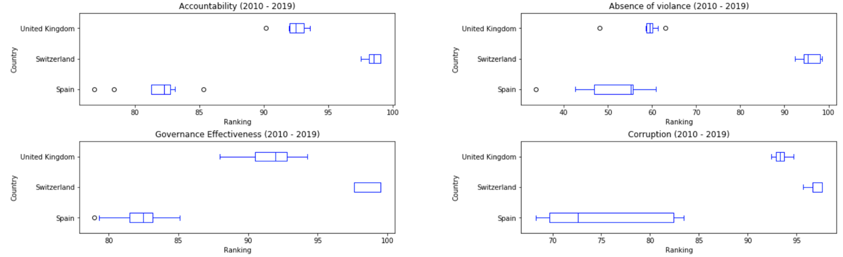
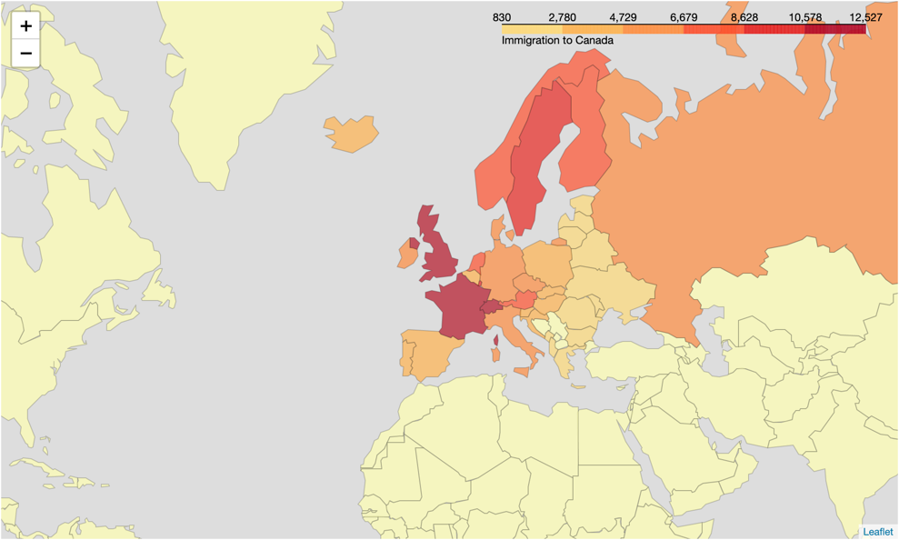
Data and Observations
Macro Economic
Regulatory view
Cost view

Slide 7
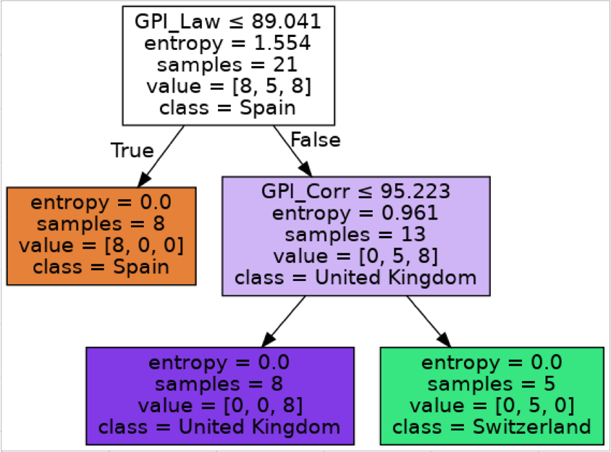
Country Selection
Purpose of the above data review was to identify the data sets providing the highest information gains on the nodes with the least variables to look at.
The model indicates that only two variables:
Index for “Rule of law”
Corruption reliance index

Slide 8
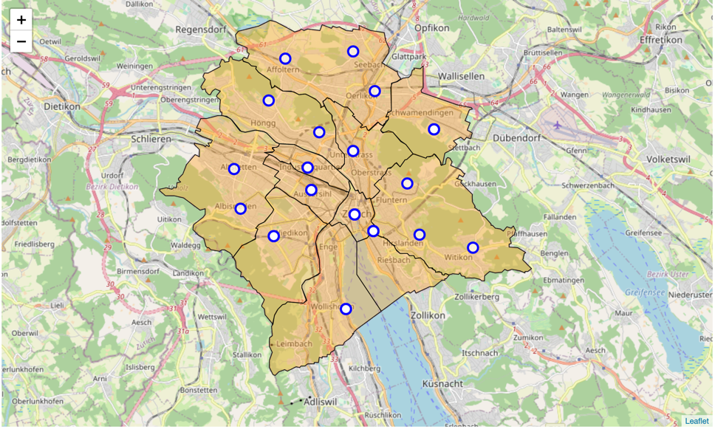
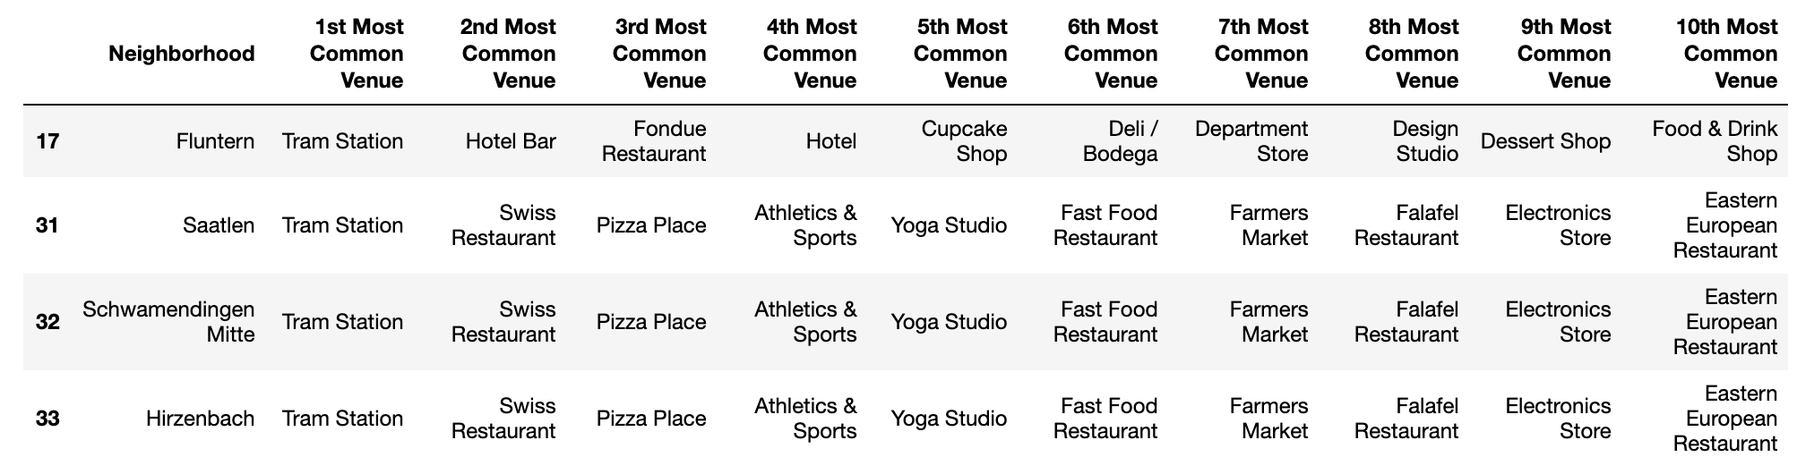
Finetuning the selction
Zurich as an international City is subdivided into 11 boroughs
We’d recommend to locate the new Europe headquarter in Zurich in the borough of Fluntern/ZH

Slide 9
Discussion of the results / method
This work was highly hypothetical and hence might not hold all data points , a company would consider.
It can however lead the process as a template.
The challenge in this work was less based on the statistical validity of the analysis but primarily on the demonstration of the following skills:
Finding, collecting harmonizing data from multiple sources
Building a data framework which allows the deployment of machine learning techniques, despite the small sample of data
Application of multiple data visualization techniques, i.e. boxplot, superimposed maps and decision trees
Handling of at least two machine learning techniques
Formulation of report demonstrating the skills

